Slide 1

TRAVEL DESTINATION
BOOKING SYSTEM

Slide 2

Travel Destination Booking System
Group No: 6
Group members:
YASH KAIN (18-BCA-095)
BIJESH THOMAS (18-BCA-156)
VINAY VINCENT (18-BCA-110)
Internal guide:
MS. CECIL JOHNY
External guide:
Mr. Jugal Prajapati

Slide 3


INDEX
COMPANY INTRODUCTION
INTRODUCTION OF THE PROJECT
REQUIREMENT GATHERING
EXISTING SYSTEM
NEW SYSTEM
TOOLS AND TECHNOLOGY
CONTEXT LEVEL
LEVEL 1

Slide 4
1.
Company Introduction
Aarnik
Technology……..

Slide 5

Company Introduction
Aarnik Technology, as a website development company that holds a reputed image among our contemporaries. They assure best services to clients for all the work related to website development. Website Development by their firm is completely original and unique. They have professionals working for the client’s website development projects that are relied upon them.
Their Roadmap starts with the mission, which is enduring. Aarnik Technology has always been delivering the most revolutionary and at the same time, powerful and well-timed solutions in website development
Client satisfaction is found very convenient and they care for the trust that our clients have in us and so we assure you to keep our quality up to the mark.

Slide 6






Services provided by company:
Website Development
Mobile App Development
Custom Development
Digital Marketing
Graphics Designing
ERP Software Development

Slide 7

Contact Details
Address: K-7,Shree Krishna Center Above Crossword Library Mithakhali Six Road, Navrangpura, Ahmedabad, Gujarat, India – 380009
Contact number: (+91) 9586248516
Email ID: info@aarniktechnology.com
Website: https://aarniktechnology.com/

Slide 8
2.
Project Introduction
Travel Destination
Booking System……..

Slide 9

Introduction Of The Project
We are going to develop a web application on Travel destination booking system.
The objective of this project is to develop a system that automates the processes and activities of a travel agency.
The purpose is to design a system using which one can perform all operations related to travelling.
The project has its unique features for the users.
Considering the present situation of the travel system, who face difficulties in finding their suitable packages, the idea of this system was brought.
It’s a system where user can explore options of their wish as per their request and come up with their own packages.

Slide 10
3.
Requirement Gathering
The
Entities……..

Slide 11

Requirement Gathering
There are five entities in our system, that are: Admin, Visitor, Traveler, Hotel and Agency.
Visitor, Hotels and Agencies can register themselves into the system.
All users can login into the system.
Admin will manage the details of travelers, hotels and agencies.
Visitor can see all the packages.
Traveler can search for pre defined packages
Traveler can perform booking and payment.
Hotel and Agency will update their booking status.

Slide 12
4.
Existing System
The Existing
System……..

Slide 13

Existing System
There is no such system available in the internet like ours, though some fractions of features has been taken from websites like www.makemytrip.com and www.redbus.com
In present situation customer face difficulty in finding the proper package for themselves because the predefined and fixed package availability.
In present system a customer has to approach various agencies to find details of places and to book tickets.

Slide 14
5.
New System
The New
System……..

Slide 15
New System
The aim of the proposed system is to design a system using which one can perform all operations related to travelling.
The user register their details and is allowed to choose package according to his/her needs.
Traveler can create a package as per his/her wish.
There will be transparency throughout the system.
The proposed system will reduce the physically done activities of both the traveler and the Agency/Hotel.

Slide 16

New System(Admin)
Admin can login.
Admin will be managing the database.
Admin will be categorizing the registered entities as per their fields.
Admin will let the traveler select packages as per their needs.
Admin can manage the details of the traveler.
Admin can manage the details of the Agencies.
Admin can manage the details of the Hotels.
Admin will manage feedbacks the users.
Admin will manage complaints by the users.

Slide 17

New System(Visitor)
Visitor can view packages defined in the system.
Visitor can view the feedback.
Visitor can search for Hotels and agencies.
Visitor can register to the system after full acknowledgement.

Slide 18

New System(Traveler)
Traveler can login.
Traveler can search for packages.
Traveler even can create his/her own package.
Traveler can perform booking task by entering the respective data.
Traveler can confirm and perform payment transaction.

Slide 19

New System(Hotel)
Hotel can register themselves to the system.
Hotel can login.
Hotel will share details to the admin.
Hotel can share booking status to the traveler.
Hotel can share payment status to the traveler.

Slide 20

New System(Agency)
Agency can register themselves to the system.
Agency can login.
Agency will share details to the admin.
Agency can share booking status to the traveler.
Agency can share payment status to the traveler

Slide 21
6.
Tools & Technology
Tools & Tech. used
in our System……..

Slide 22




Tools And Technology
Platform:
Front End: Django 3.1 (Python)
Backend: MySQL 5.5
Other Tools:
Presentation tool: Microsoft Power Point 2019
Drawing tool: Edraw Max

Slide 23
7.
Data Flow Diagram
The DFDs
used in
our system……..

Slide 24
Context Level DFD

Slide 25
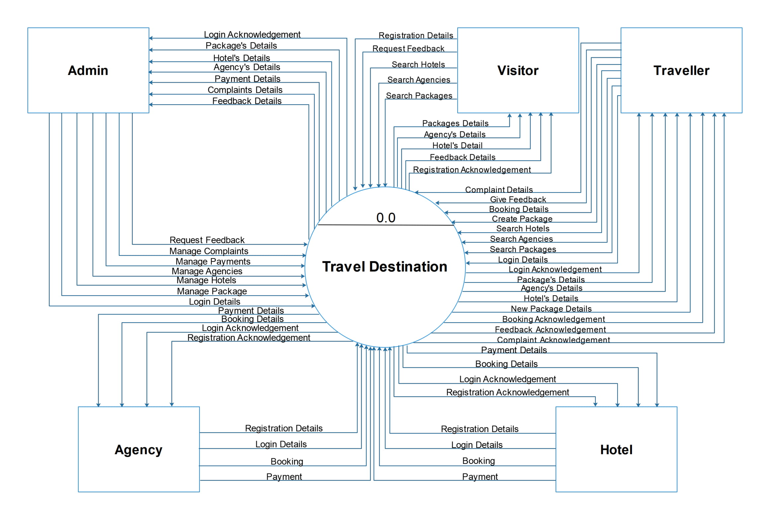

Slide 26
Level 1 DFD

Slide 27
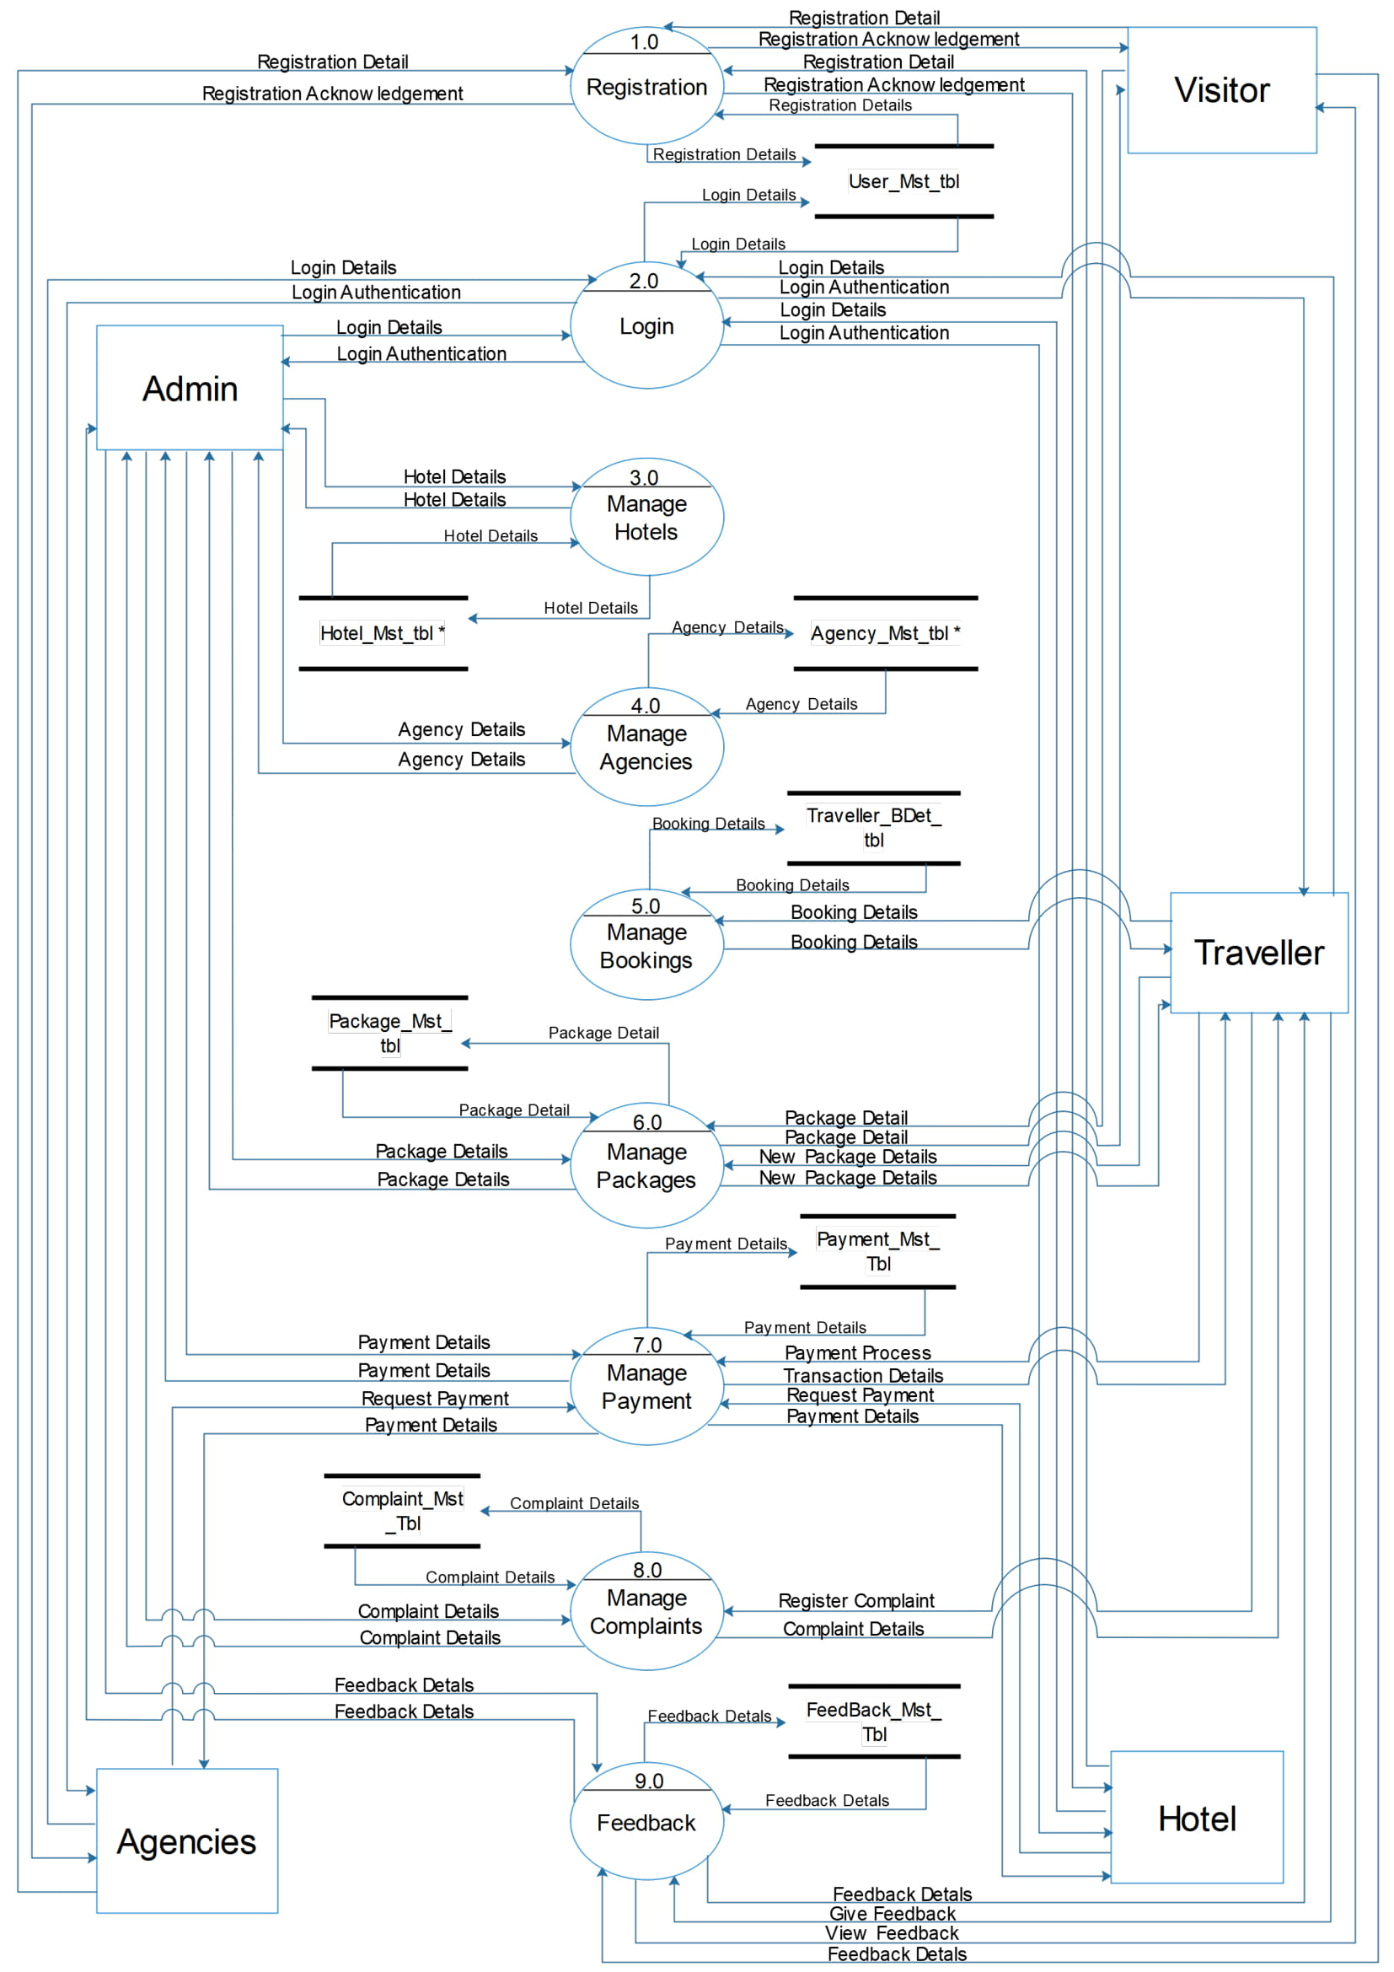

Slide 28
Level 2: Login(2.0)

Slide 29
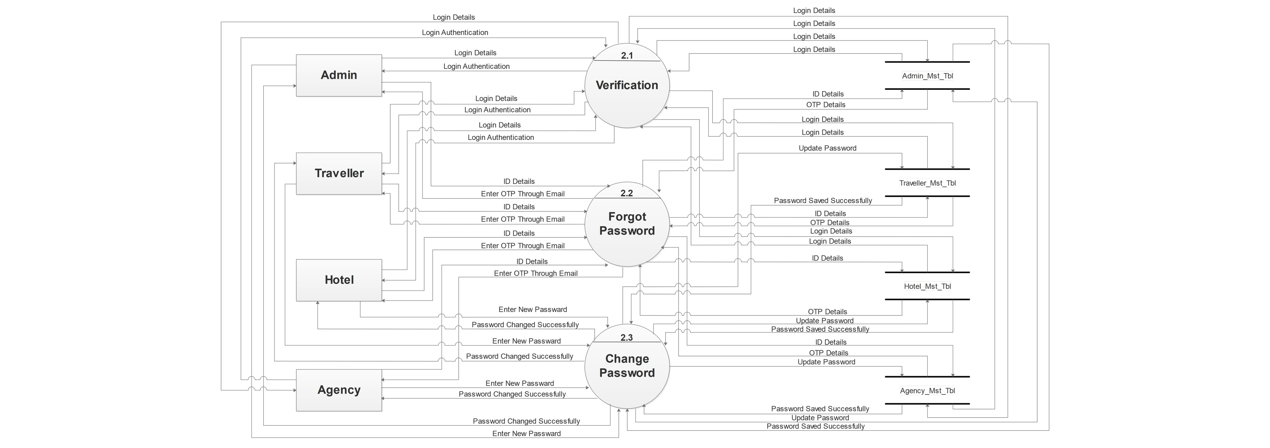

Slide 30
Level 2: Hotel(3.0)

Slide 31
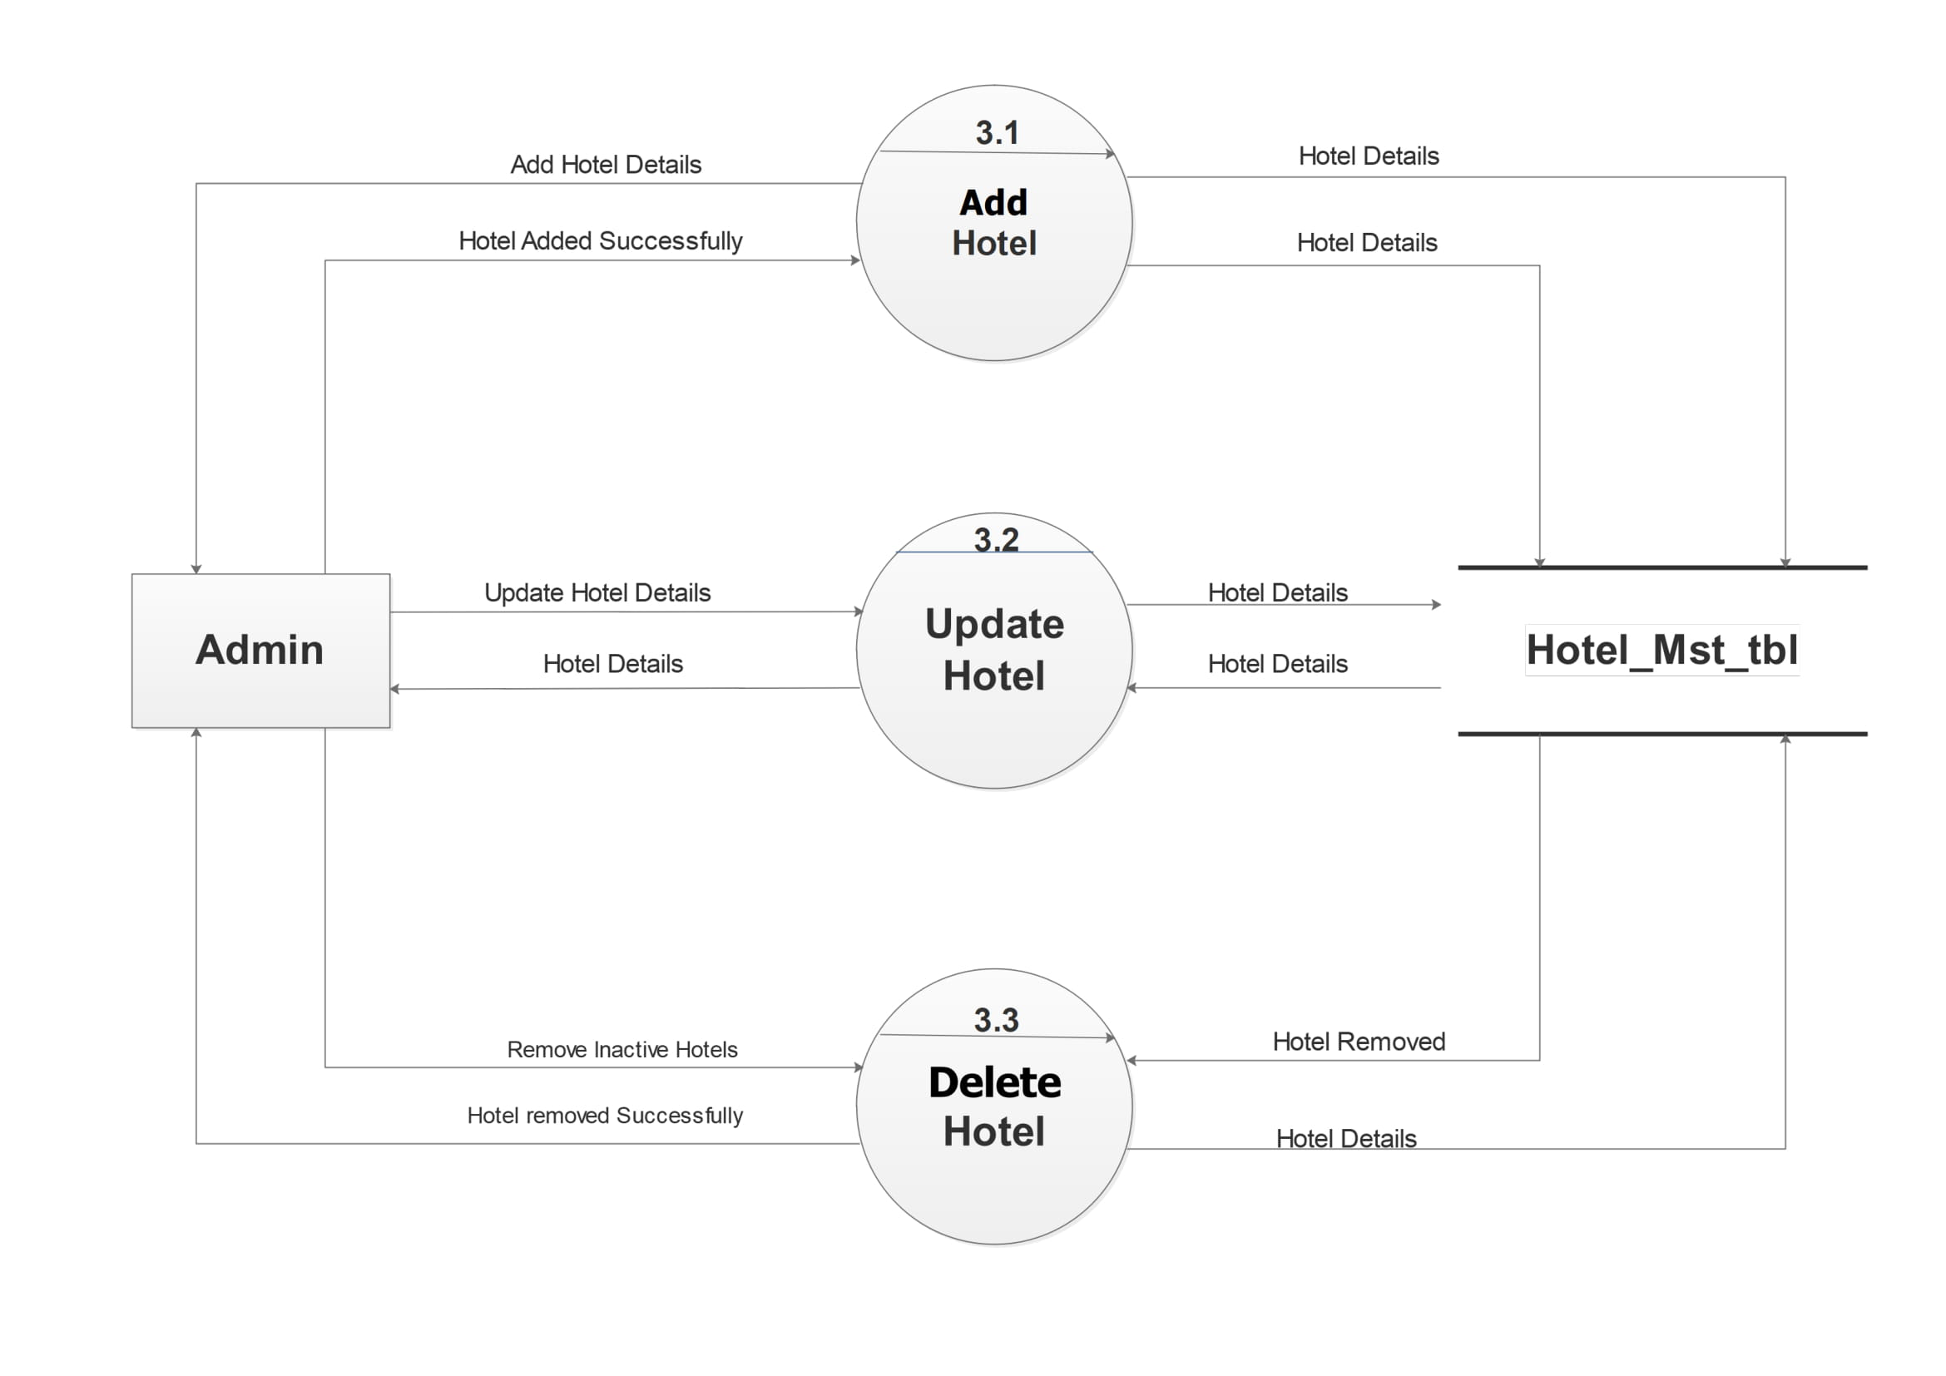

Slide 32
Level 2: Agency(4.0)

Slide 33
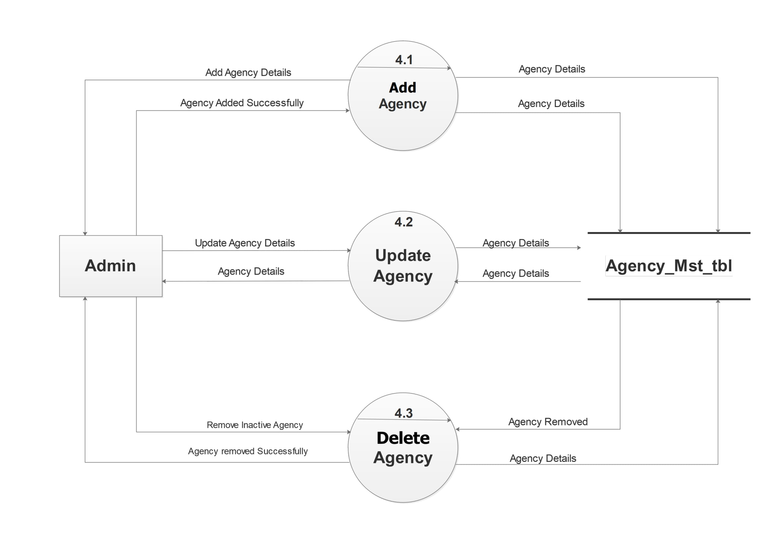

Slide 34
Level 2: Packages(5.0)

Slide 35
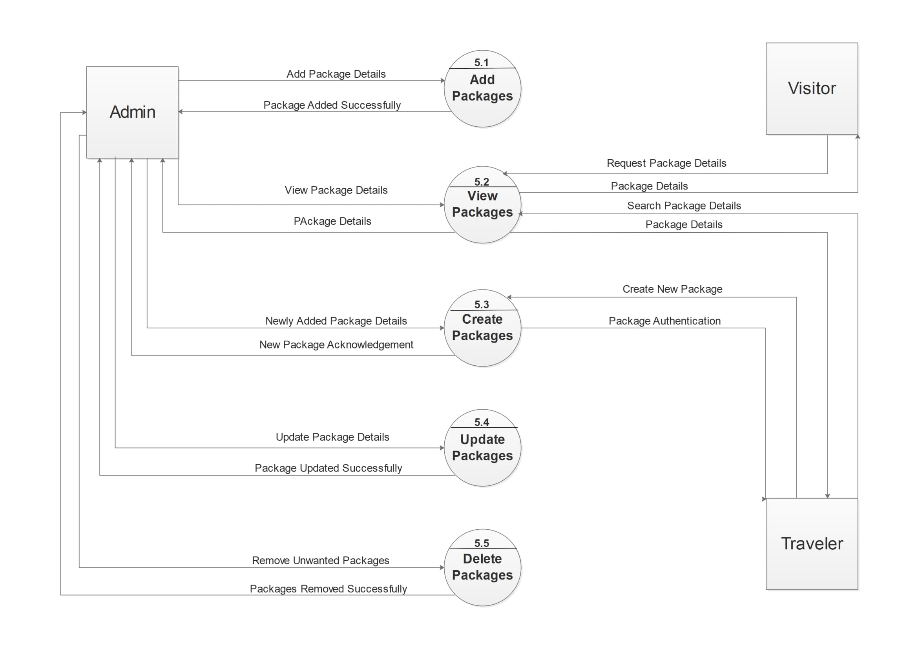

Slide 36
Level 2: Booking(6.0)

Slide 37
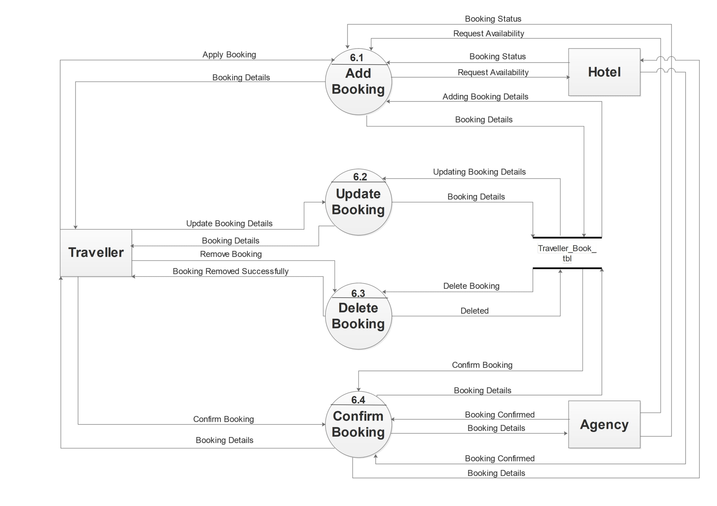

Slide 38
Level 2: Payment(7.0)

Slide 39
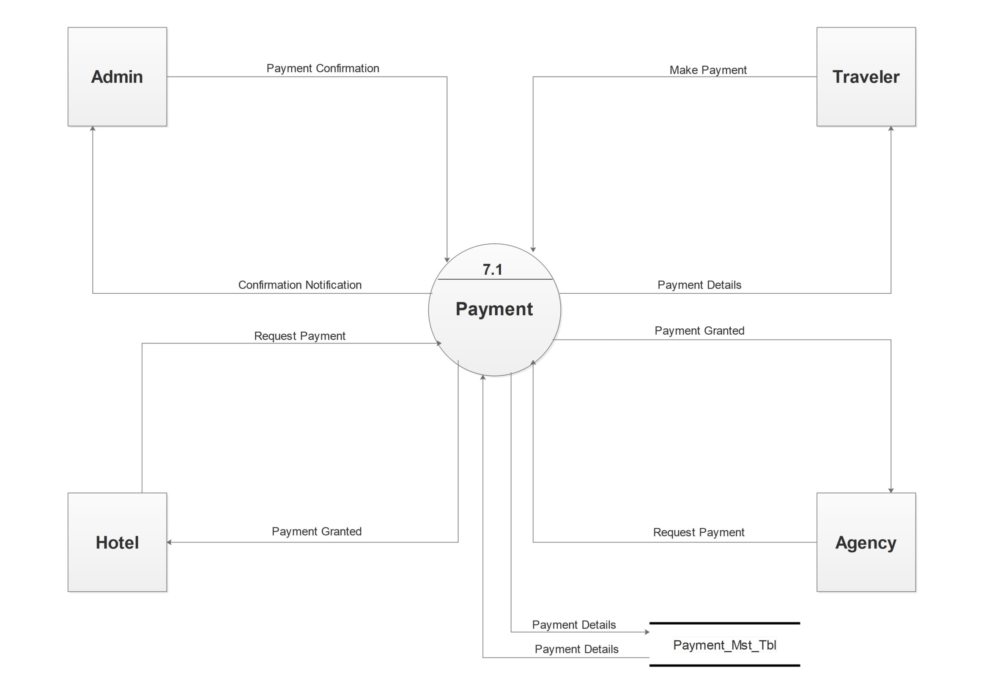

Slide 40
Level 2: Complaint(8.0)

Slide 41
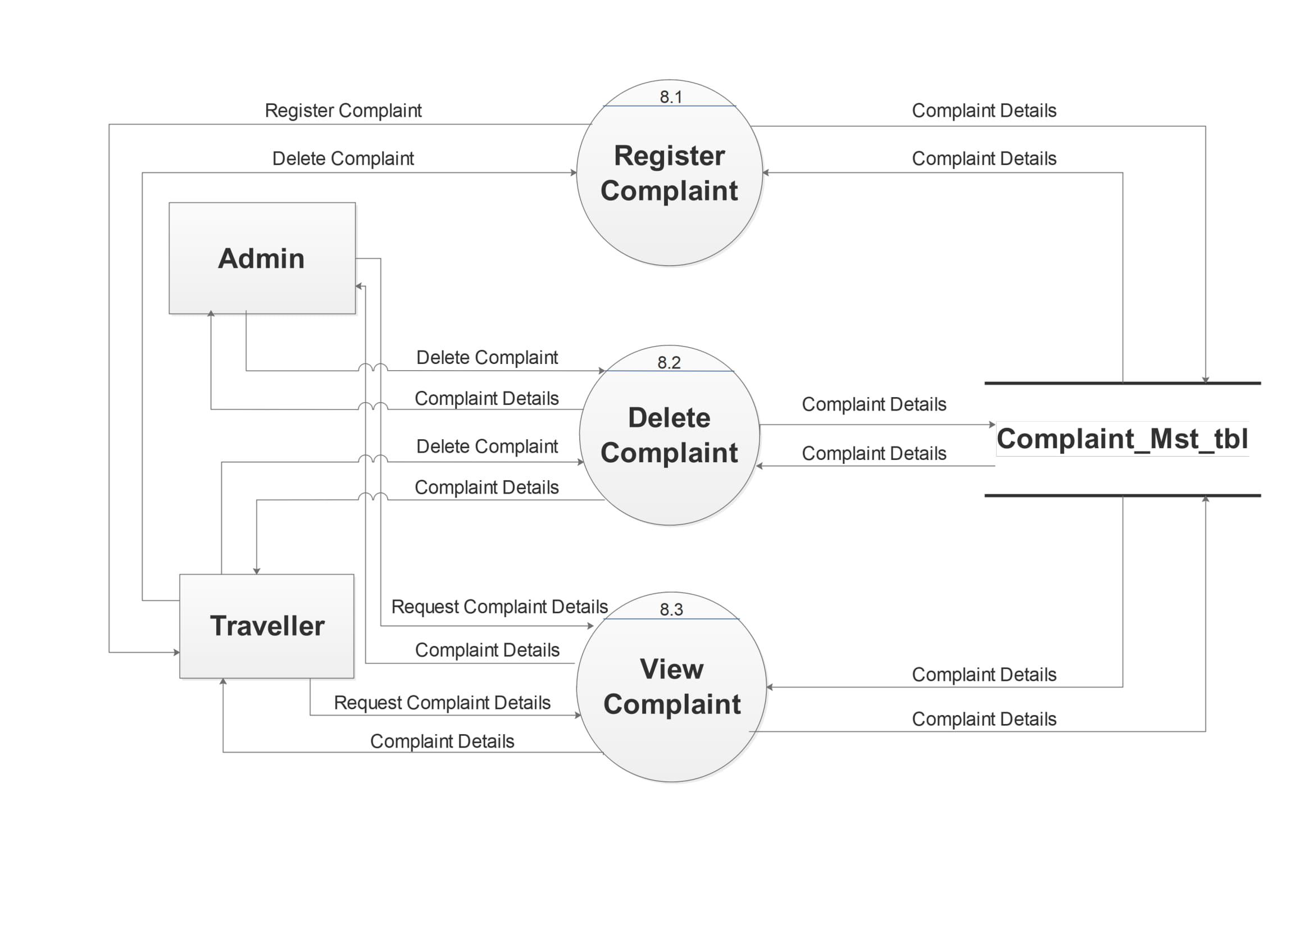

Slide 42
Level 2: Feedback(9.0)

Slide 43
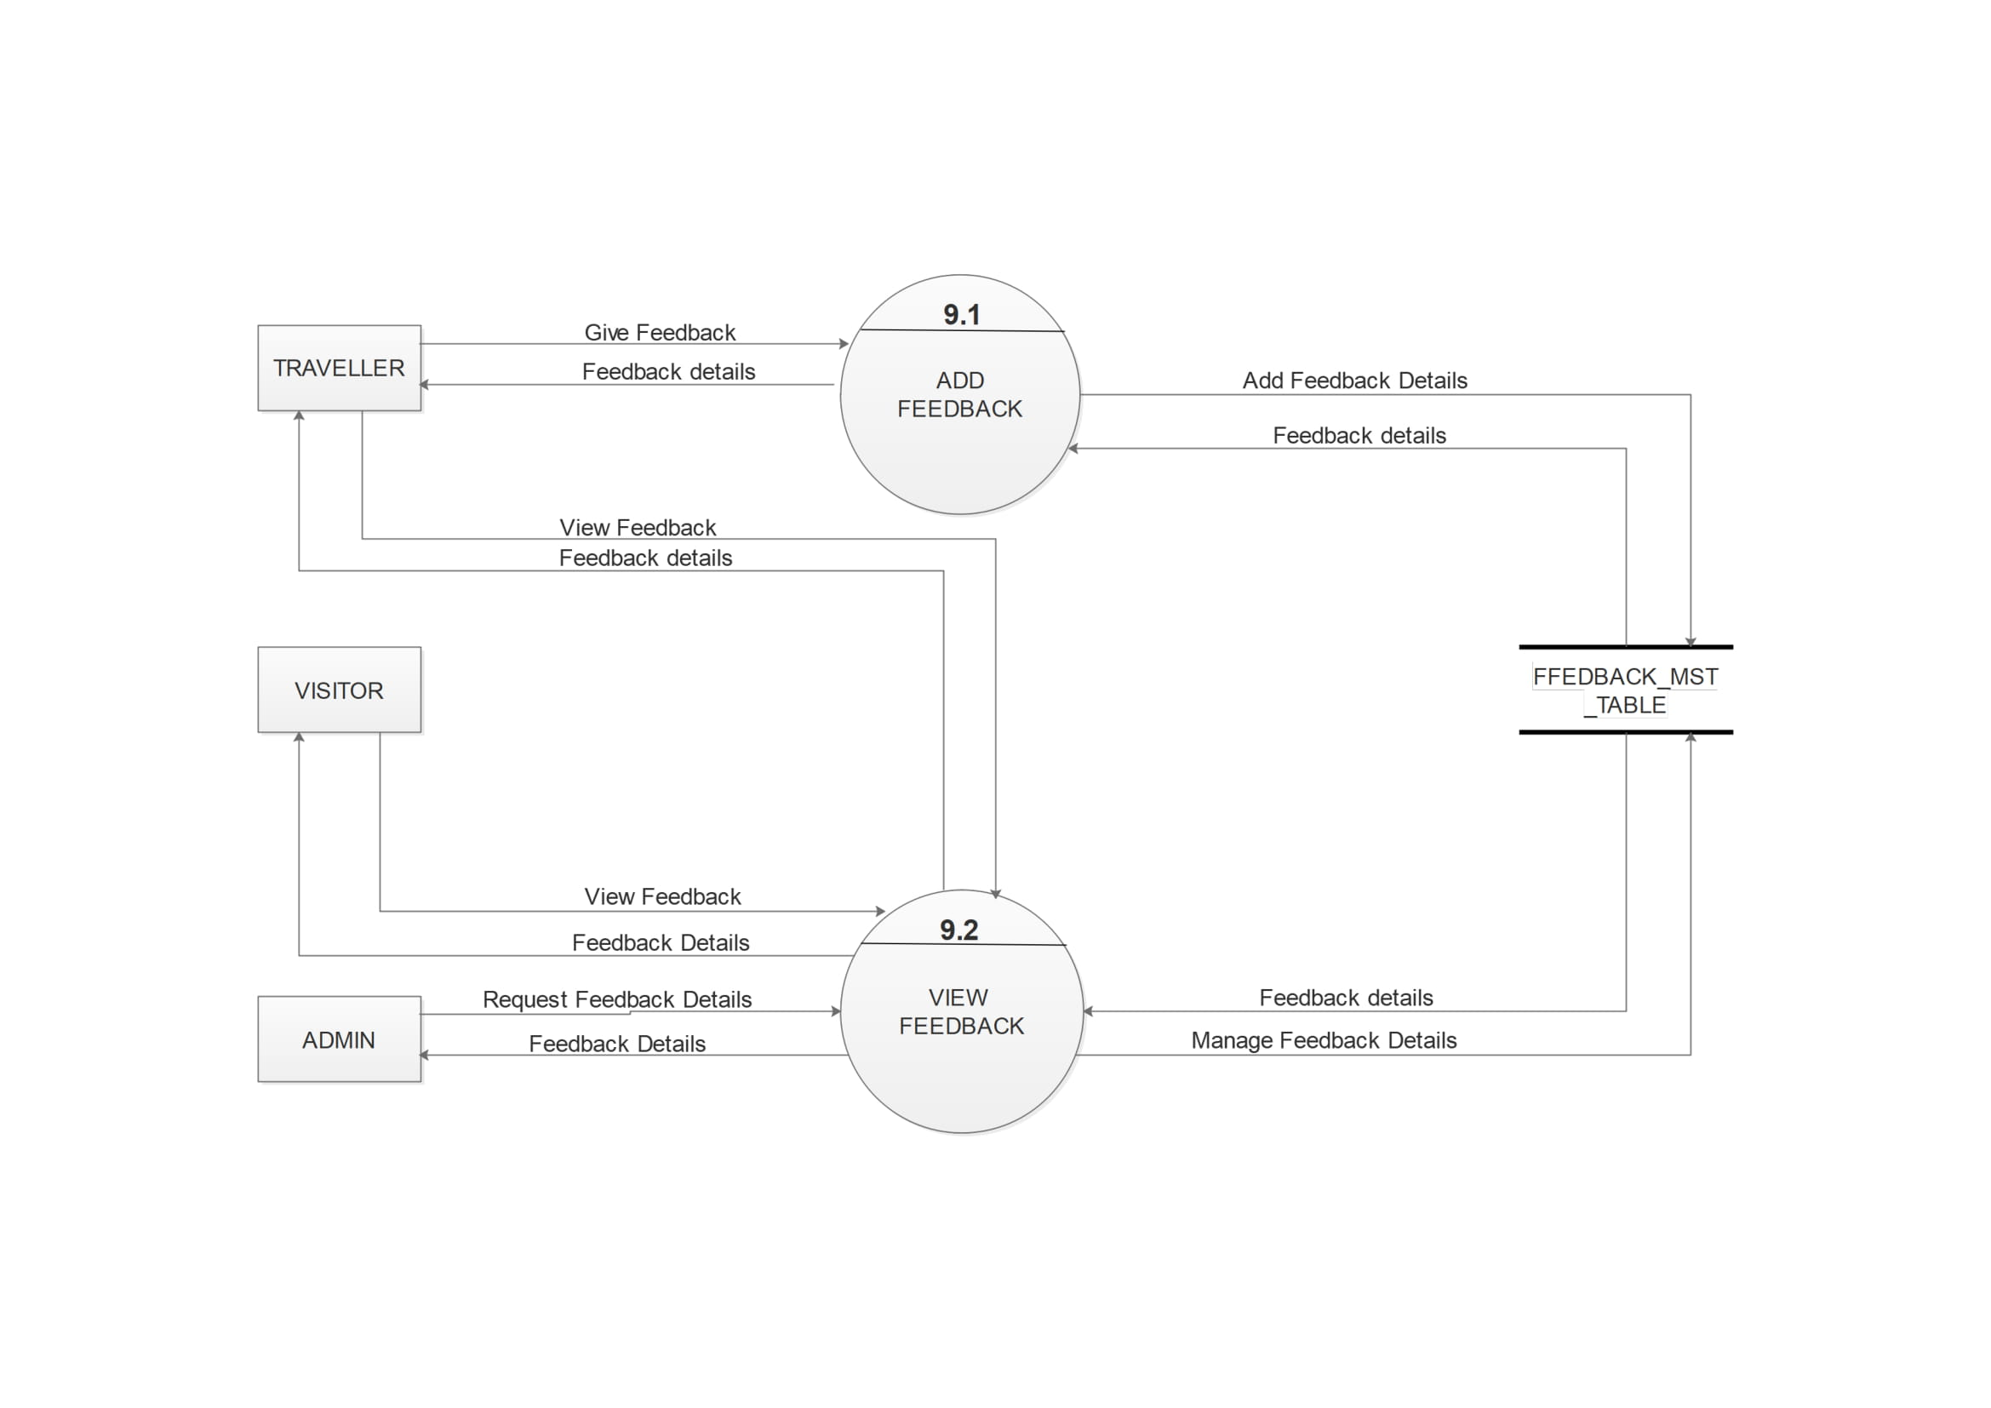

Slide 44
8. Entity Relationship Diagram
This is the
ERD of our
system……..

Slide 45
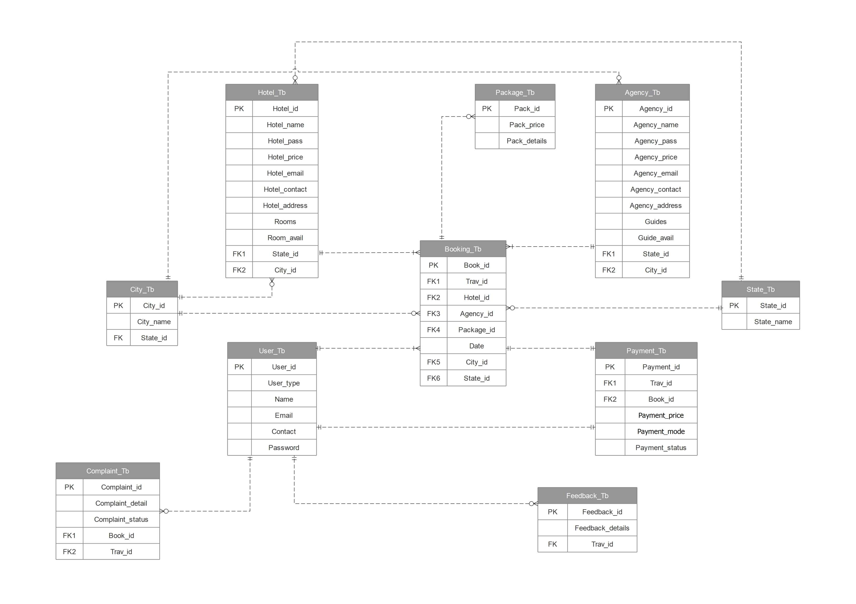

Slide 46
9. Data Dictionary
In the DD,
you will see……..

Slide 47
Data Dictionaries
User_Mst_Table
Hotel_Mst_Table
Agency_Mst_Table
Booking_Mst_Table
Packages_Mst_Table
Payment_Mst_Table
Complaint_Mst_Table
Feedback_Mst_Table
State_Table
City_Table

Slide 48
Table name : User_Mst_Table Table Description : contain all the login details of the Admin and Traveler
Field name | Data type | Size | Constraint | Description
User_id | Varchar | 5 | Primary key | It will store the id of the users.
User_type | Varchar | 15 | Not null | It will refer whether the user is Admin or Traveler.
Name | Varchar | 10 | Not null | It will store name of the user.
Email | Varchar | 30 | Unique, Not null | It will store the email of the users.
Contact | Number | 12 | Unique, Not null | It will store the contact details of the users.
Password | varchar | 10 | Not null | It will store the password of the users.

Slide 49
Table name : Hotel_Mst_Table Table Description : contains all the details about Hotel
Field Name | Data Type | Field size | Constraints | Description
Hotel_id | Varchar | 5 | Primary key | It will store the id of the hotel
Hotel_name | Varchar | 20 | Not null | It will store the first name of the hotel
Hotel_password | Varchar | 15 | Not null | It will store the password of the hotel
Hotel_Price | Currency | - | Not Null | It will store the price details of the Hotel
Hotel_email | Varchar | 30 | Unique, Not null | It will store the email of the hotel
Hotel_contact | Number | 12 | Not null | It will store the contact details of hotel
Hotel_address | Varchar | 50 | Not null | It will store the address of the hotel
Rooms | Number | 3 | Not Null | It stores the room number of hotel
Room_Avail | Yes/No | - | Default | It shows the room availability status
State | Varchar | 10 | Not null | It will store the state name
City | Varchar | 10 | Not null | It will store the city name

Slide 50
Table name : Agency_Mst_Table Table Description : contains all the details about agency
Field Name | Data Type | Field size | Constraints | Description
Agency_id | Varchar | 5 | Primary key | It will store the id of the agency
Agency_name | Varchar | 20 | Not null | It will store the first name of the agency
Agency_password | Varchar | 15 | Not null | It will store the password of the agency
Guide_price | Currency | - | Not Null | It will store the price of the guide
Agency_email | Varchar | 30 | Unique,Not null | It will store the email of the agency
Agency_contact | Number | 12 | Not null | It will store the contact details of agency
Agency_address | Varchar | 50 | Not null | It will store the address of the agency
Guides | Number | 3 | Not Null | It stores the number of guides
Guide_Avail | Yes/No | - | Default | It shows the room availability status
State | Varchar | 10 | Not null | It will store the state name
City | Varchar | 10 | Not null | It will store the city name

Slide 51
Table name : Booking_Mst_Table Table Description : contains all the details about booking
Field Name | Data Type | Field size | Constraints | Description
Book_id | varchar | 5 | Primary | It will store the booking id
Trav_id | varchar | 5 | Not null | It will store the id of the traveler
Hotel_id | Varchar | 5 | Not null | It will store the hotel name
Agency_id | varchar | 5 | Not null | It will store the agency name
Package_id | varchar | 5 | Not Null | It contains the Package Details of the traveler
Date | date | 8 | Not null | It will store the date
City_Id | varchar | 20 | Not null | It will store the city information
State_Id | Varchar | 20 | Not null | It will store the state information

Slide 52
Table name : Package_Mst_Table
Table description : contains all the details about packages
Field Name | Data Type | Field Size | Constraints | Description
Package_id | varchar | 5 | Primary key | It stores the id of the package
Package_price | Currency | - | Not null | It stores the price of the package
Hotel_id | varchar | 5 | Foreign Key | It stores the id of the Hotel
Agency_id | varchar | 5 | Foreign Key | It stores the id of the Agency

Slide 53
Table Name: Payment_Mst_Tbl
Table Description: Contains data related to Payments.
Field Name | Data Type | Field Size | Constraints | Description
Payment_id | Varchar | 5 | Primary key | It uniquely defines a payment.
Payment_price | Currency | - | Not null | It contains amount detail.
Payment_mode | Varchar | 10 | Not null | It specifies the mode of payment.
Payment_status | Yes/No | - | Default | Its stores the payment status
Book_id | Varchar | 5 | Foreign key, Not null | It specifies the booking id.
Trav_id | Varchar | 5 | Foreign key, Not null | It specifies traveller id.

Slide 54
Table Name: Complaint_Mst_Tbl
Table Description: Contains data related to Complaints.
Field Name | Data Type | Field Size | Constraints | Description
Complaint_id | Varchar | 5 | Primary key | It uniquely defines a complaint.
Complaint_detail | Varchar | 200 | Not null | It contains complaint detail.
Complaint_status | Yes/No | 1 | Default | Complaint resolved or not
Book_id | Varchar | 5 | Foreign key, Not null | It specifies the booking id.
Trav_id | Varchar | 5 | Foreign key, Not null | It specifies traveller id.

Slide 55
Table Name: Feedback_Mst_Tbl
Table Description: Contains data related to Feedback.
Field Name | Data Type | Field Size | Constraints | Description
Feedback_id | Varchar | 5 | Primary key | It uniquely defines a feedback.
Feedback_detail | Varchar | 200 | Not null | It specifies name of the state.
Trav_id | Varchar | 5 | Foreign key, Not null | It specifies the traveller id.

Slide 56
Table Name: State_Table
Table Description: Contains data related to States.
Field Name | Data Type | Field Size | Constraints | Description
State_id | Varchar | 5 | Primary key | It uniquely defines a state.
State_name | Varchar | 20 | Not null | It specifies name of the state.

Slide 57
Table Name: City_Table
Table Description: Contains data related to Cities.
Field Name | Data Type | Field Size | Constraints | Description
City_id | Varchar | 5 | Primary key | It uniquely defines a city.
City_name | Varchar | 20 | Not null | It specifies name of the city.
State_id | Varchar | 5 | Foreign key, Not null | It uniquely defines a state.

Slide 58
Thank You!
Any questions?

